Slide 1
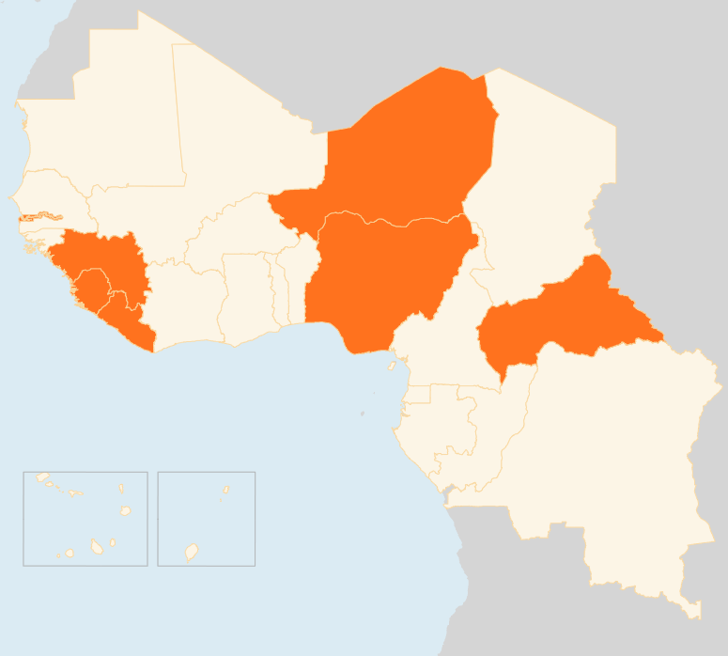



7- 13 April 2015
WEST AFRICA
CENTRAL AFRICAN REPUBLIC (CAR)
BANGUI AIRPORT IDP SITE TO BE SHUT
The transitional government has announced that the Mpoko airport IDP site will be closed by the end of May. The site hosts some 18,300 IDPs, nearly 80 percent of whom are from Bangui’s Third District. The decision follows a recent study by the Danish Refugee Council on the intention of return/relocation where it was noted that the large majority of IDPs are prepared to return. Particular attention will be given to reintegration in areas of return. Insecurity in certain neighbourhoods remains a major challenge especially for IDPs who want to return to the Third District.
LIBERIA
0 CASES SINCE 27 MARCH
No new confirmed cases were recorded over the reporting week. As of 12 April Liberia had gone for 17 days without any confirmed case. The last patient infected with the virus died on 27 March. Only two people in the whole country are being monitored. Meanwhile on 8 April the health ministry has validated an “Investment Plan for Resilient Health Services” as well as transition plan for the next six months in the wake of the Ebola epidemic.
NIGER
CHICKEN FARM ISOLATED OVER BIRD FLU FEARS
Authorities have isolated a chicken farm in the southern Maradi town due to suspected bird flu outbreak. Maradi is near the border with Nigeria, which has confirmed cases of the virus in several states in the north. The decision follows the death of more than 2,000 chickens in the farm. Samples have been sent to Italy for testing. Importation of chickens from the town has been banned.
NIGERIA
800,000 CHILDREN DISPLACED BY INSURGENCY
An estimated 800,000 children have been driven from their homes by Boko Haram violence, UNICEF said in a report published on 13 April. The “Missing Childhoods” report was released on the eve of the anniversary of the kidnapping of 276 schoolgirls from the remote town of Chibok. The majority of the schoolgirls remain in the hands of the militants, whose insurgency has also uprooted 1.2 million people in north-eastern Nigeria.
REGIONAL / EBOLA VIRUS DISEASE (EVD)
30 CASES RECORDED, LOWEST SINCE MAY 2014
In the week that ended on 5 April, a total of 30 cases were reported in Guinea (21) and Sierra Leone (9). These were the lowest figures in almost one year. No infections were reported in Liberia, where the last EVD patient died on 27 March. Overall, 25,515 suspected, confirmed and probable cases and 10,572 deaths have occurred in the three countries.
WEST AFRICA
4.7 MILLION FACING crisis-level FOOD insecurity
From March - May 4.7 million people will be in crisis phase (IPC 3) in Cape Verde, Guinea-Bissau, Mauritania, Mali, Niger, Sierra Leone and Chad due to significant decrease in harvests, according to the Harmonized Framework. The number could rise to 7.3 million people - including Burkina Faso, Senegal and Liberia - during the June-August lean season due to food price increases and the declining purchasing power of poor households.
4.7M
FACING CRISIS-LEVEL
FOOD INSECURITY
NIGER
GUINEA
DEAD, SEVERAL INJURED IN DEMONSTRATIONS
CHICKEN FARM ISOLATED OVER BIRD FLU FEARS
1
NIGERIA
800k
CHILDREN DISPLACED BY INSURGENCY
CAR
AIRPORT IDP SITE TO BE SHUT
LIBERIA
REGIONAL / EVD
0
EBOLA CASES SINCE 27 MARCH
30
CASES, LOWEST SINCE MAY 2014
Creation date: 13 April 2014
Map data sources: UNCS, DevInfo, OCHA.
The boundaries and names shown and the designations used on this map do not imply official endorsement or acceptance by the United Nations

